Slide 1
Exploratory Analysis on Synthesised Transaction Dataset
Created By: Aamir Mapkar
Email: mapkaraamir@gmail.com
Tool: Microsoft PowerBI

Slide 2
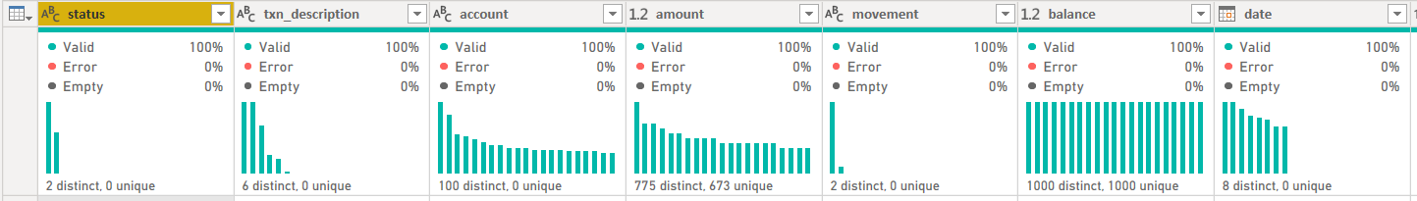
Data Exploration
The dataset consist of 12000+ transactions, with information about the customer, transaction details, merchant details, etc.
For current analysis, only a few of these transaction information are important and they don’t exhibit any bad or null value. (Ref. Image 1)
A few transformations had to be applied to prepare the data for visualization which are detailed below:
The transaction’s location information is stored in the form of space separated latitude and longitude values in a single column. These are extracted and stored in new columns.
Dataset had personally-identifiable-information about the customer, i.e. Customer Name, which was deleted to preserve privacy.
Transaction Description had two conflicting names for same type of transaction, i.e. POS and SALES-POS which had to be combined.
Day and Hour of the transaction is extracted to visualize transaction volume based on them.
Image 1: Data Exploration and quality check
Image 1: Data Exploration and quality check

Slide 3
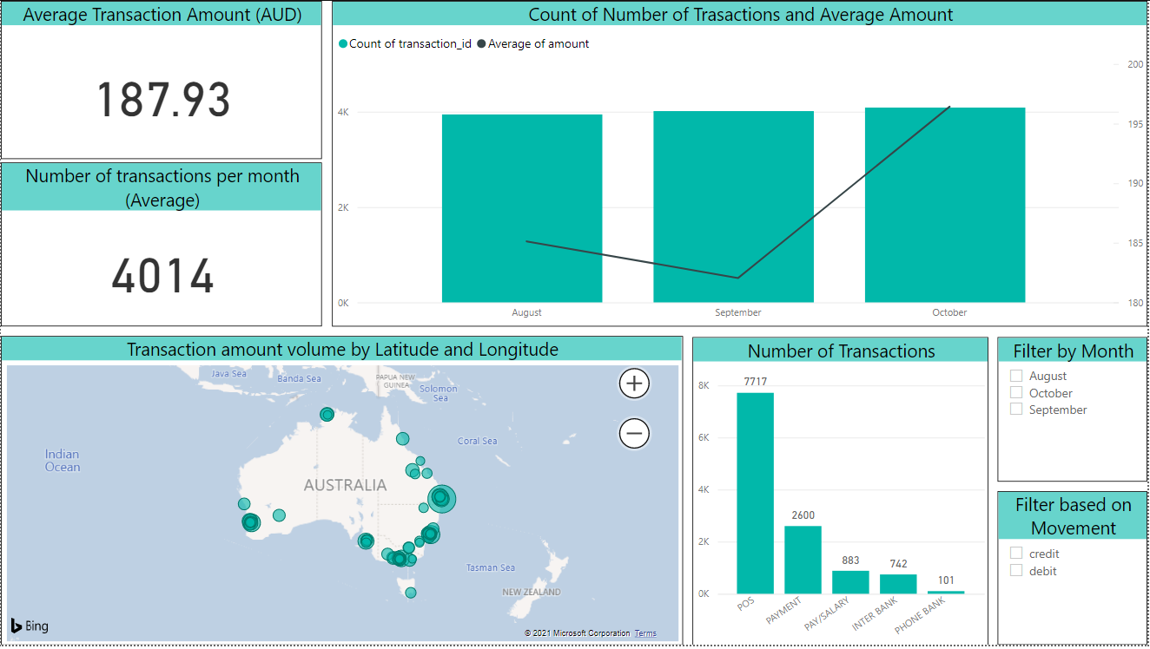
Data Analysis and Insights – Dashboard (Overview)
Number of Transactions (bar) and Average Transaction Amount (line) indicate while the number of transactions were similar, average transaction amount rose in October.
Average Transaction Amount (Credit and Debit) for the entire dataset and Average Number of Transactions per month can be viewed here.
Number of Transactions per Category can be seen here. POS transactions accounted for more than 50% of all transactions.
Location of the circle represents of location of a certain transaction while the size represents count of transaction in that location.
Filters can be applied to modify all the visualizations to get granular data.
Click here to go to Dashboard

Slide 4
Data Analysis and Insights – Dashboard (Key Features)
Bar graph for average number and amount of transactions can be drilled up and down to view data for the month, day of the month, day of the week or time of the day. This will allow the management to get insights based on the granularity required. (Refer Appendix A, B, C and D)
Selecting any of the transaction description will filter all visualizations based on that filter. This can enable analysis based on different departments such as POS, Phone banking etc. (Refer Appendix E)
Hovering over any data point on the map will display customer account information along with a summary of credit and debit transactions for each month. (Refer Appendix F)

Slide 5
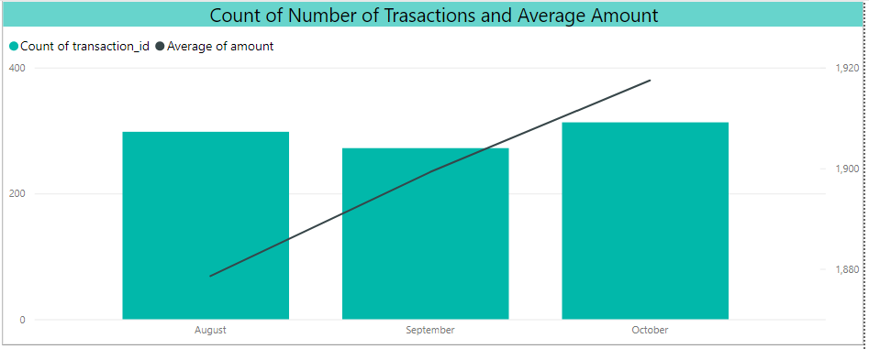
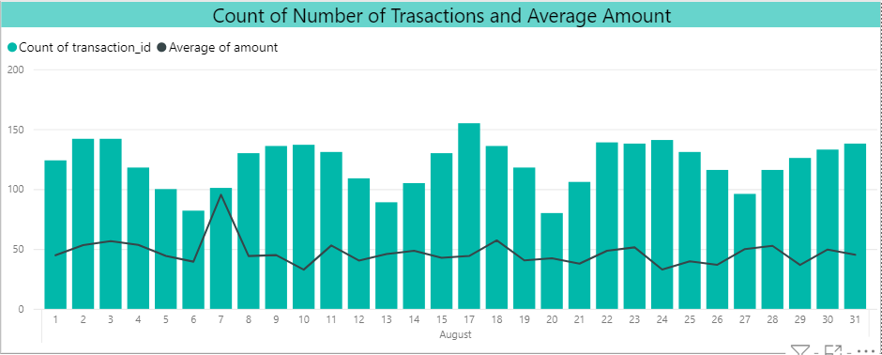
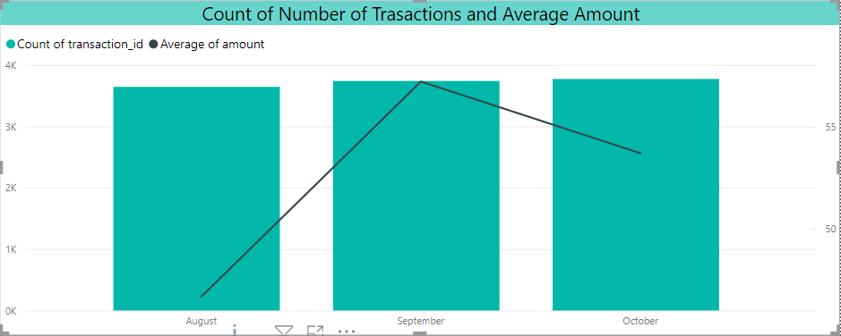
Data Analysis and insights (Key insights)
Average Salary Amount: 1900 AUD, with 294 transaction in a month. Average salary amount rose steadily across the months (Ref. Image 2).
Average Debit Amount: 52.57 AUD, with 3720 transaction in a month (Ref. Image 3).
Number of debit transactions have uniform weekly distribution, peaking in the middle of the week (Ref. Image 4).
Major chunk of the transactions are occurring in major Australian cities.
Image 2: Bar graph depicting count of transactions and average amount (credit only)
Image 4: Bar graph depicting daily count of transactions and average amount (debit only)
Image 3: Bar graph depicting count of transactions and average amount (debit only)

Slide 6
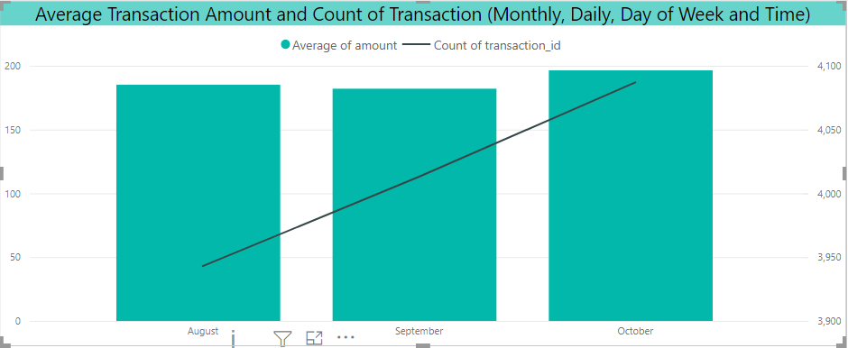
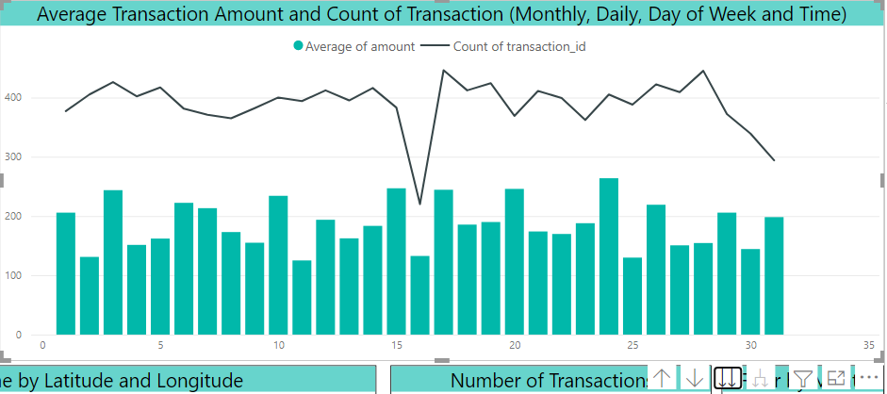
Appendix
Appendix A: Average Transaction Amount and Number of transactions - Monthly
Appendix B: Average Transaction Amount and Number of transactions – Day of the Month

Slide 7
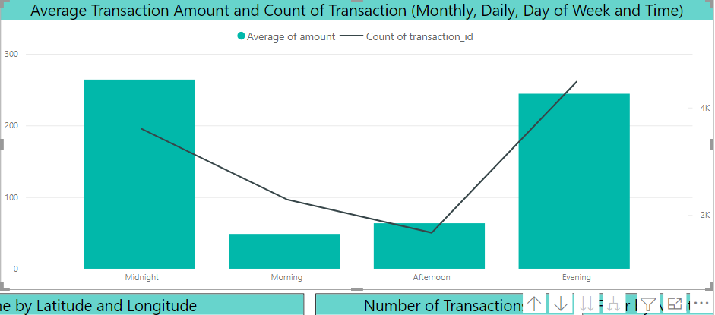
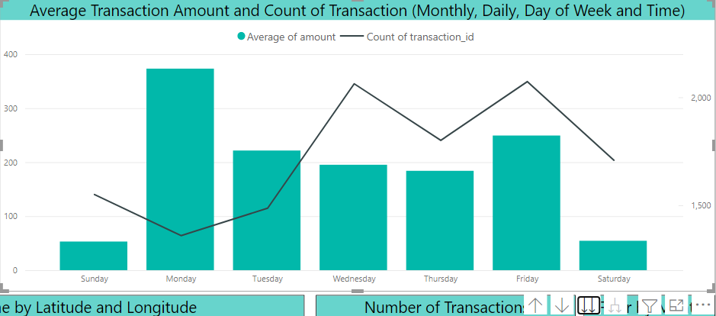
Appendix - Continued
Appendix C: Average Transaction Amount and Number of transactions – Day of the Week
Appendix D: Average Transaction Amount and Number of transactions – Time of the Day

Slide 8
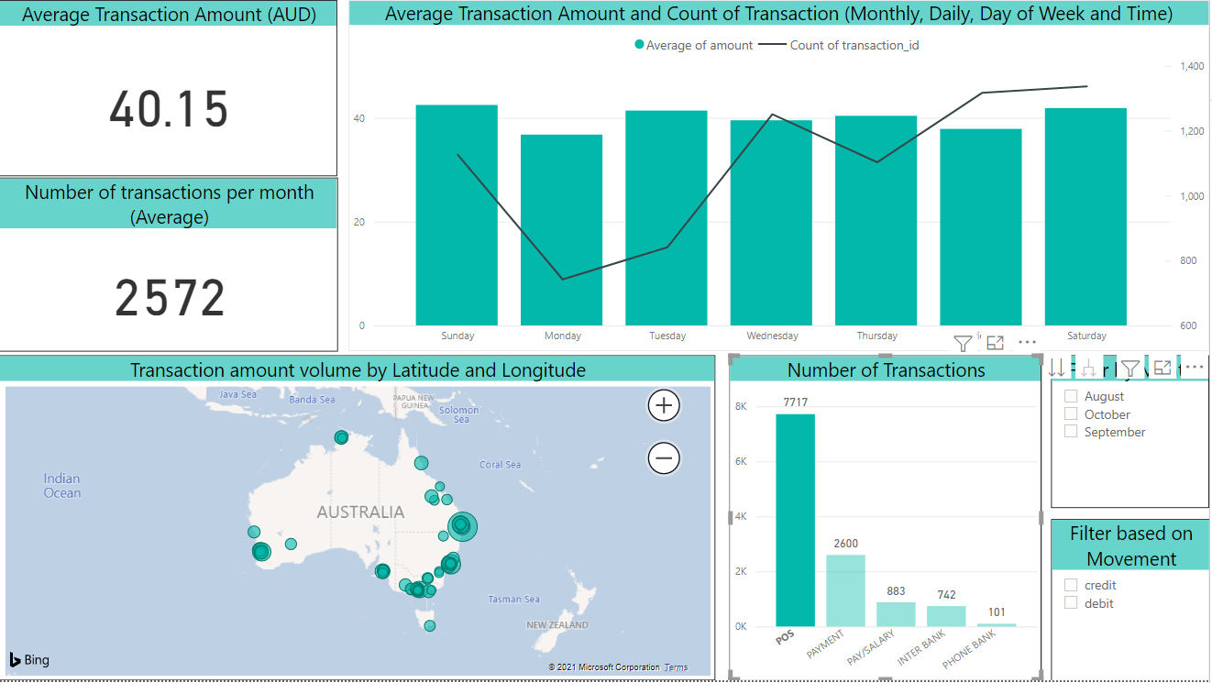
Appendix - Continued
Appendix E: Dashboard filtered on POS transactions

Slide 9
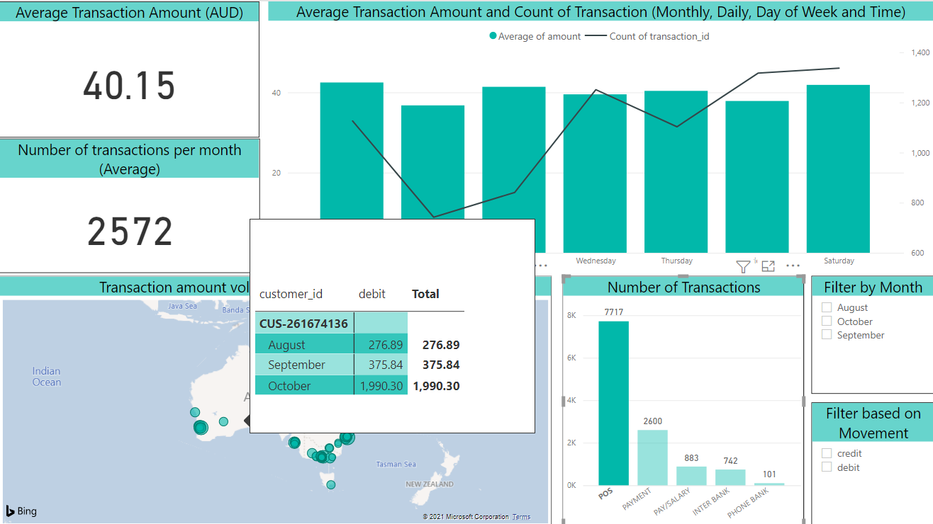
Appendix - Continued
Appendix F: Dashboard filtered on POS transactions with pop-up window on map

